Slide 1
JAVASCRIPT DOM
By Eduard Luchuk

Slide 2
AGENDA
Introducing DOM
Walking the DOM
Manipulating DOM with JavaScript
Useful links

Slide 3
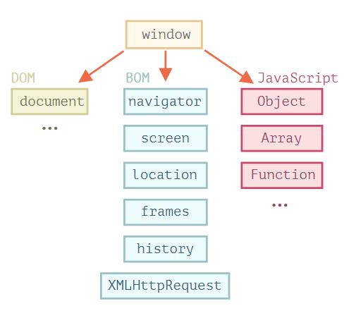
INTRODUCING DOM
Document Object Model, or DOM for short, represents all page content as objects that can be modified.
DOM allows programmers generic access to adding, deleting, and manipulating - of all styles, attributes, and elements in a document.
It can be accessed via any language available in the browser.
Every tag, attribute, style, and piece of text is available to be accessed and manipulated via the DOM :
adding and removing tags,
attributes and styles,
animating existing elements,
and hiding/ showing elements on a page.

Slide 4
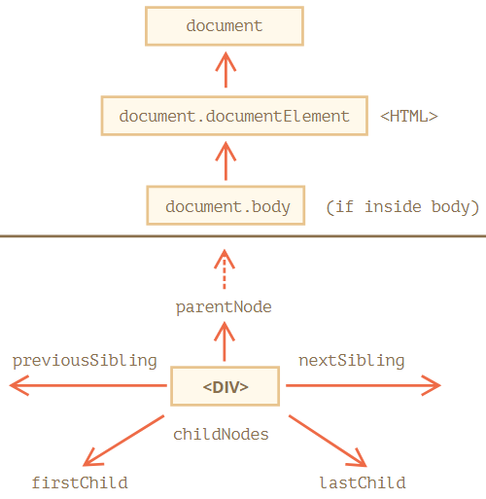
WALKING THE DOM
There are 12 node types. In practice we usually work with 4 of them:
document – the “entry point” into DOM.
element nodes – HTML-tags, the tree building blocks.
text nodes – contain text.
comments – sometimes we can put information there, it won’t be shown, but JS can read it from the DOM.

Slide 5
WALKING THE DOM
Relationship properties
firstChild is the first child node for the current node
lastChild is the last child object for the current node
childNodes is an array of all the child nodes under a node
previousSibling is the sibling before the current node
nextSibling is the sibling after the current node
parentNode is the object that contains the current node

Slide 6
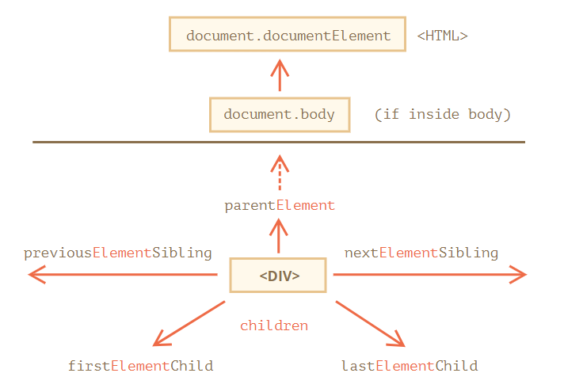
WALKING THE DOM
Navigation links that only take element nodes into account

Slide 7
WALKING THE DOM
Finding HTML Elements
if an element has the id attribute, we can get the element using this method
document.getElementById(id)
returns all elements inside elem matching the given CSS selector
document.querySelectorAll(css)
returns the first element for the given CSS selector
document.querySelector(css)
looks for elements with the given tag and returns the collection of them
document.getElementsByTagName(tag)
returns elements that have the given CSS class
document.getElementsByClassName(className)

Slide 8
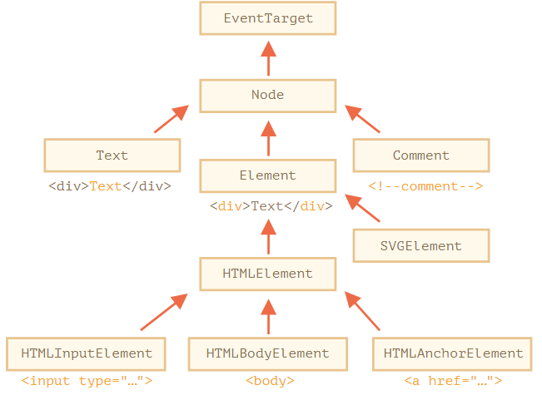
WALKING THE DOM
Node classes
EventTarget – is the root “abstract” class
Node – is an “abstract” class, serving as a base for DOM nodes
Element – is a base class for DOM elements
HTMLElement – is the basic class for all HTML elements. It is inherited by concrete HTML elements:
HTMLInputElement – the class for <input> elements,
HTMLBodyElement – the class for <body> elements,
HTMLAnchorElement – the class for <a> elements,
…and so on

Slide 9
WALKING THE DOM
Node properties
DOM node
nodeType
innerHTML
outerHTML
nodeValue/
data
textContent
Hidden
elem.nodeType == 1 || 3 || 9
nodeName/
tagName
document.body.nodeName
document.body.tagName
document.body.innerHTML
elem.outerHTML
document.body.firstChild.data
elem.textContent
elem.hidden = true

Slide 10
WALKING THE DOM
Attributes and properties
loading HTML
generating DOM objects
building DOM-tree
HTML attributes become properties of DOM objects
parsing
Methods which are used to access to all attributes
sets the value
elem.setAttribute(name, value)
removes the attribute
checks for existence
elem.removeAttribute(name)
elem.hasAttribute(name)
gets the value
elem.getAttribute(name)

Slide 11
MANIPULATING DOM WITH JAVASCRIPT
Creating an element
Creates a new element node with the given tag
document.createElement(tag)
Creates a new text node with the given text
document.createTextNode(text)

Slide 12
MANIPULATING DOM WITH JAVASCRIPT
Insertion methods:
appends nodes or strings at the end of node
node.append(...nodes or strings)
inserts nodes or strings at the beginning of node
node.prepend(...nodes or strings)
inserts nodes or strings before node
node.before(...nodes or strings)
inserts nodes or strings after node
node.after(...nodes or strings)
replaces node with the given nodes or strings
node.replaceWith(...nodes or strings)

Slide 13
MANIPULATING DOM WITH JAVASCRIPT
Insertion methods:
the method to insert an HTML string “as html”
elem.insertAdjacentHTML(where, html)
"beforebegin" – insert html immediately before elem,
"afterbegin" – insert html into elem, at the beginning,
"beforeend" – insert html into elem, at the end,
"afterend" – insert html immediately after elem.
"<p>Hello</p>"

Slide 14
MANIPULATING DOM WITH JAVASCRIPT
Node removal
It is a method to remove a node
node.remove()
Cloning nodes
creates a “deep” clone of the element – with all attributes and subelements
elem.cloneNode(true)
the clone is made without child elements
elem.cloneNode(false)

Slide 15
MANIPULATING DOM WITH JAVASCRIPT
Old-school
parent.appendChild(node)
parent.insertBefore(node, nextSibling)
parent.removeChild(node)
parent.replaceChild(newElem, node)
document.write(html)

Slide 16
MANIPULATING DOM WITH JAVASCRIPT
Classes changing
elem.classList
is a special object with methods:
adds/removes the class
elem.classList.add/remove("class")
adds the class if it doesn’t exist, otherwise removes it
elem.classList.toggle("class")
checks for the given class, returns true/false
elem.classList.contains("class")
elem.className
replaces the whole string of classes, if we assign something

Slide 17
MANIPULATING DOM WITH JAVASCRIPT
Element style changing
is an object that corresponds to what’s written in the "style" attribute
elem.style
is a special property to set the full style as a string
style.cssText

Slide 18
SUMMARY
An HTML document is represented inside the browser as the DOM tree.
Tags become element nodes and form the structure.
Text becomes text nodes.
…etc, everything in HTML has its place in DOM, even comments.
Given a DOM node, we can go to its immediate neighbors using navigation properties (“parentNode”, “childNodes”, “firstChild”, “lastChild”, “previousSibling”, “nextSibling”).
By far the most used are “querySelector” and “querySelectorAll”, but “getElementBy*” can be sporadically helpful or found in the old scripts.
Each DOM node belongs to a certain class. The classes form a hierarchy. The full set of properties and methods come as the result of inheritance.
Attributes – is what’s written in HTML. Properties – is what’s in DOM objects.

Slide 19
USEFUL LINKS
DOM Living Standard
Introduction to the DOM
Chrome-devtools
Live DOM Viewer

Slide 20


